Slide 1
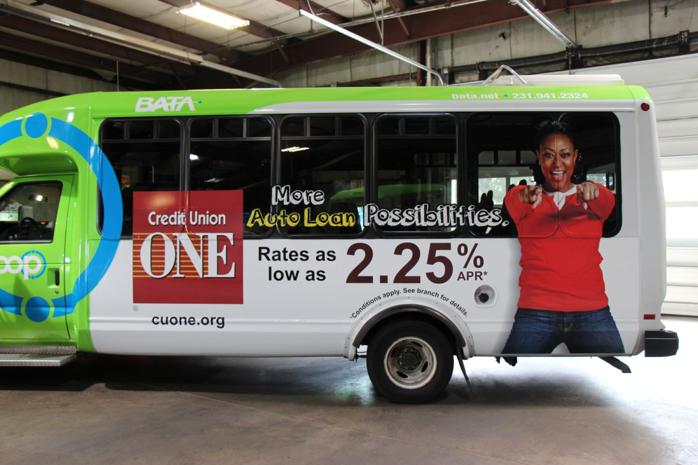
Credit Union ONE Traverse City bus wrap – grand opening

Slide 2
Credit Union ONE Traverse City grand opening – No Text Zone partnership

